Slide 1
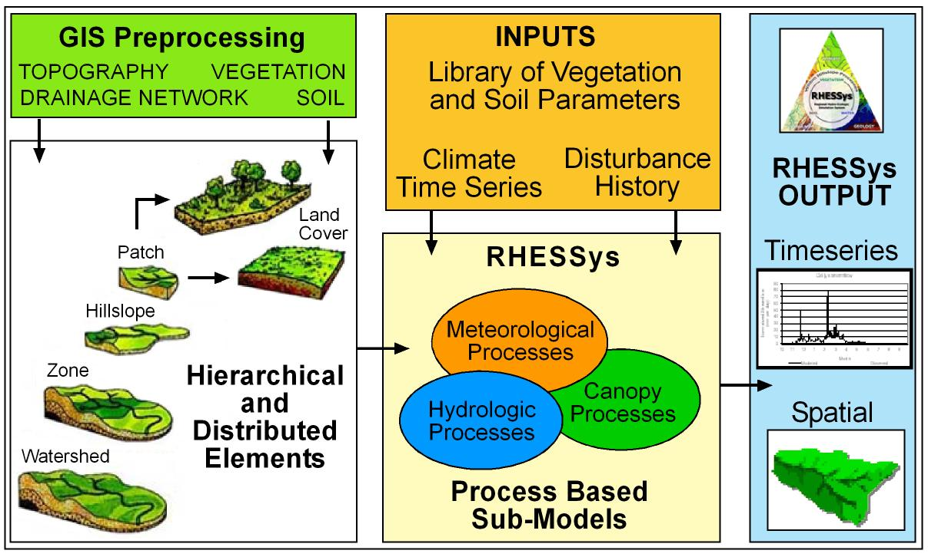
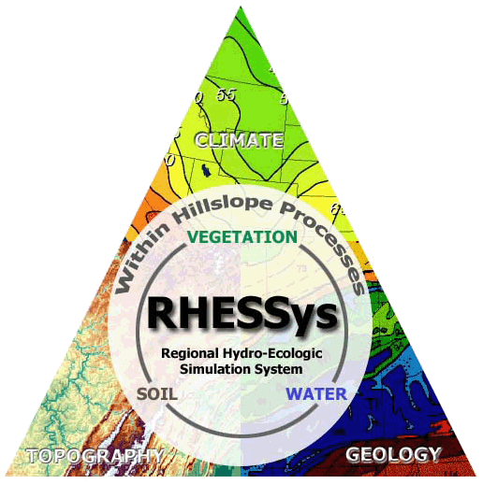
Regional Hydro-Ecologic Simulation System (RHESSys)
Ryan R Bart
Sierra Nevada Research Institute
University of California, Merced

Slide 2
RHESSys
Regional Hydro-Ecological Simulation System
A distributed computer simulation of spatially distributed ecosystem processes at the watershed scale, designed to simulate water, carbon and nutrient cycling and transport over spatially variable terrain.
Captures the temporal and spatial variability of ecosystem processes at a daily time step over multiple years by applying a set of physically based process sub-models over spatially variable terrain.
https://github.com/RHESSys/RHESSys
Notes:
It does this by using a number of interface programs which organize input data into the necessary format. These include a GIS that represents different elements of the landscape, and rhessys specific programs that derive the landscape representation from the GIS images and establish connectivity between spatial units.

Slide 3
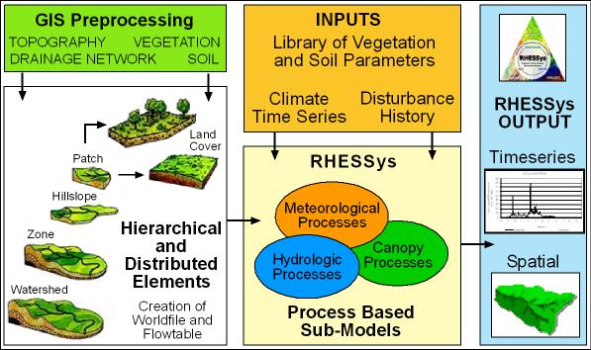
RHESSys Model Process

Slide 4
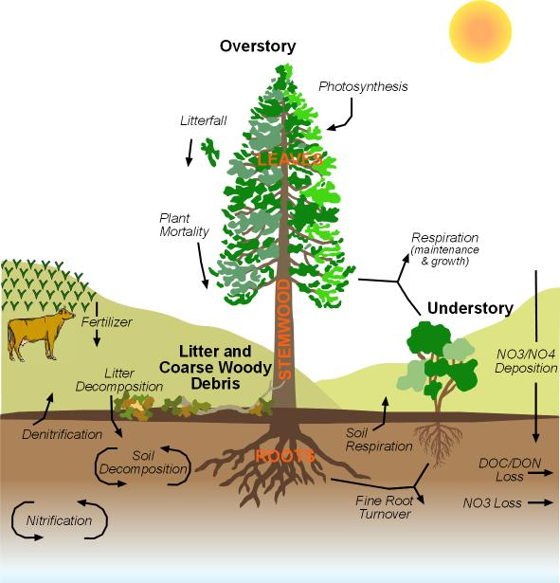
Carbon and Nitrogen cycling in RHESSys
Energy (radiation), carbon, nitrogen and water balance
Stand competition for water, light, nutrients
Feedback between NPP, growth, phenology, and soil biogeochemical cycling

Slide 5
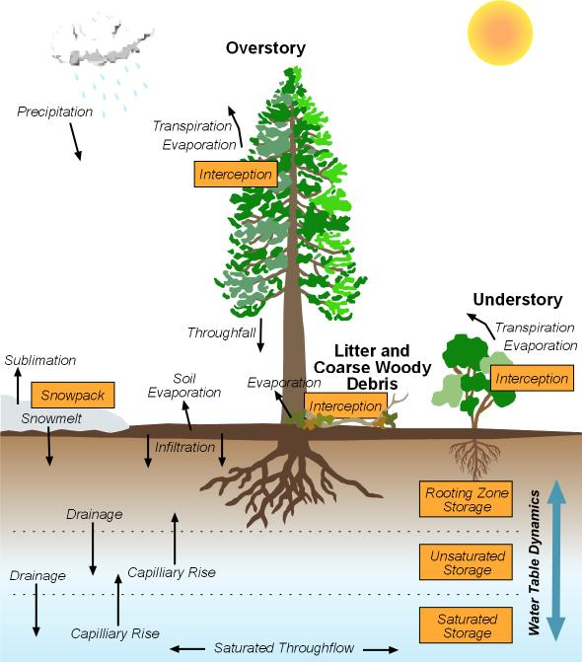
Vertical drainage in RHESSys

Slide 6
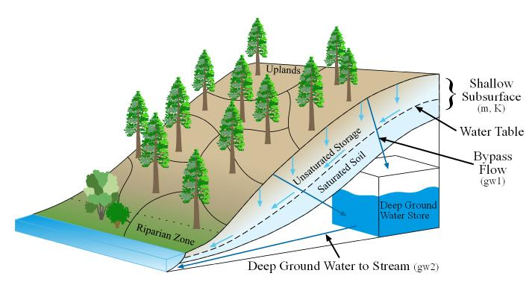
Lateral drainage in RHESSys

Slide 7
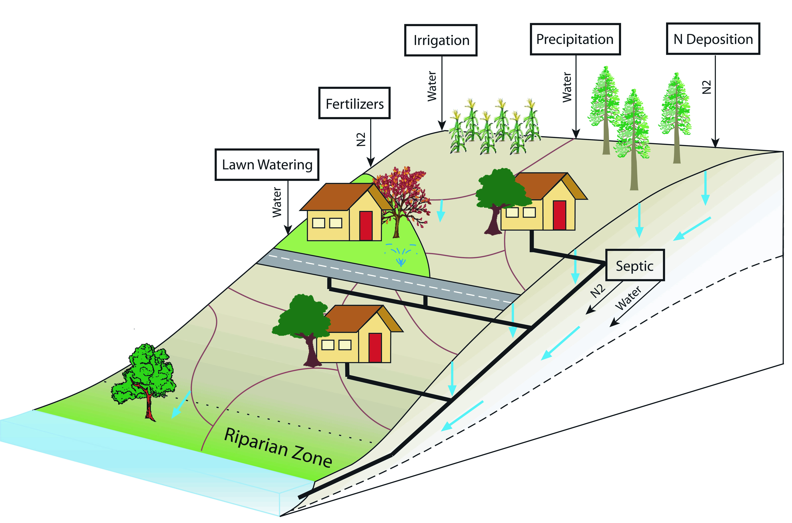
Modeling the Urban landscape in RHESSys

Slide 8
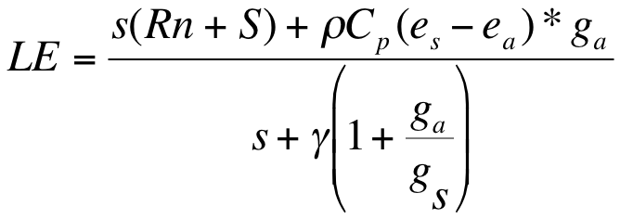

Transpiration (Penman-Monteith)
Photosynthesis (Farquhar)
F(Ac,Aj) - both of which include Ci (concentration of carbon in leaves) which depends on gs
Stomatal Conductance (Jarvis Model)
gs = f(Tmax,Tmin,LWP, atm C02, Radiation, VPD)
gs_canopy = gs*LAI
LWP (leaf water potential)
SWP (soil water potential) linked with distributed hydrologic model and its parameterization

Slide 9
Gross PSN f(light, nutrient availability, conductance), and leaf area
Respiration maintenance and growth f(T, N and biomass)
varies with type and size of plant components
=
NPP Allocated to leaves, stems, roots and carbohydrate storage; which impact photosynthetic capacity and respiration costs
Potentially complex dynamics because you have a system with feedbacks and multiple controls
That carbon cycling models give you “reasonable” forest biomass for particular sites is not trivial; suggests that carbon cycling (rather than structural or some other mechanism) can explain growth and equilibrium size of stands

Slide 10
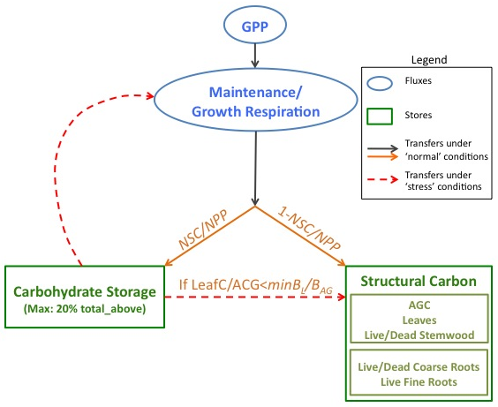

Allocation to and use of non-structural carbohydrate storage (NSC)
Two new parameters: (NSC/NPP proportion of NPP allocation to NSC; minL/ABC)

Slide 11
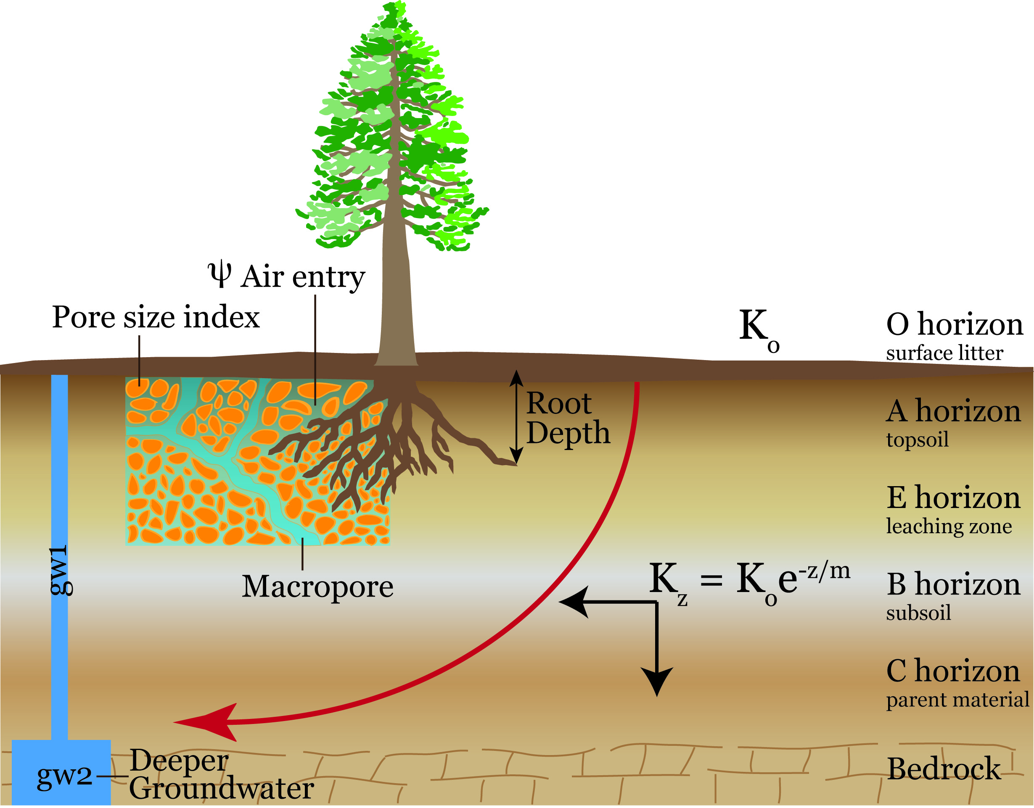
Calibrated soil drainage parameters

Slide 12
Coupled RHESSys-WMFire
Ecohydrologic model, RHESSys, which is a distributed, mechanistic model of carbon and water cycling.
Dynamically incorporate wildfire into an ecohydrology model, such that fire model affects, and is affected by, ecohydrologic model projections.
Ecohydrologic Model
Fire Spread Model
Fire Effects Model

Slide 13
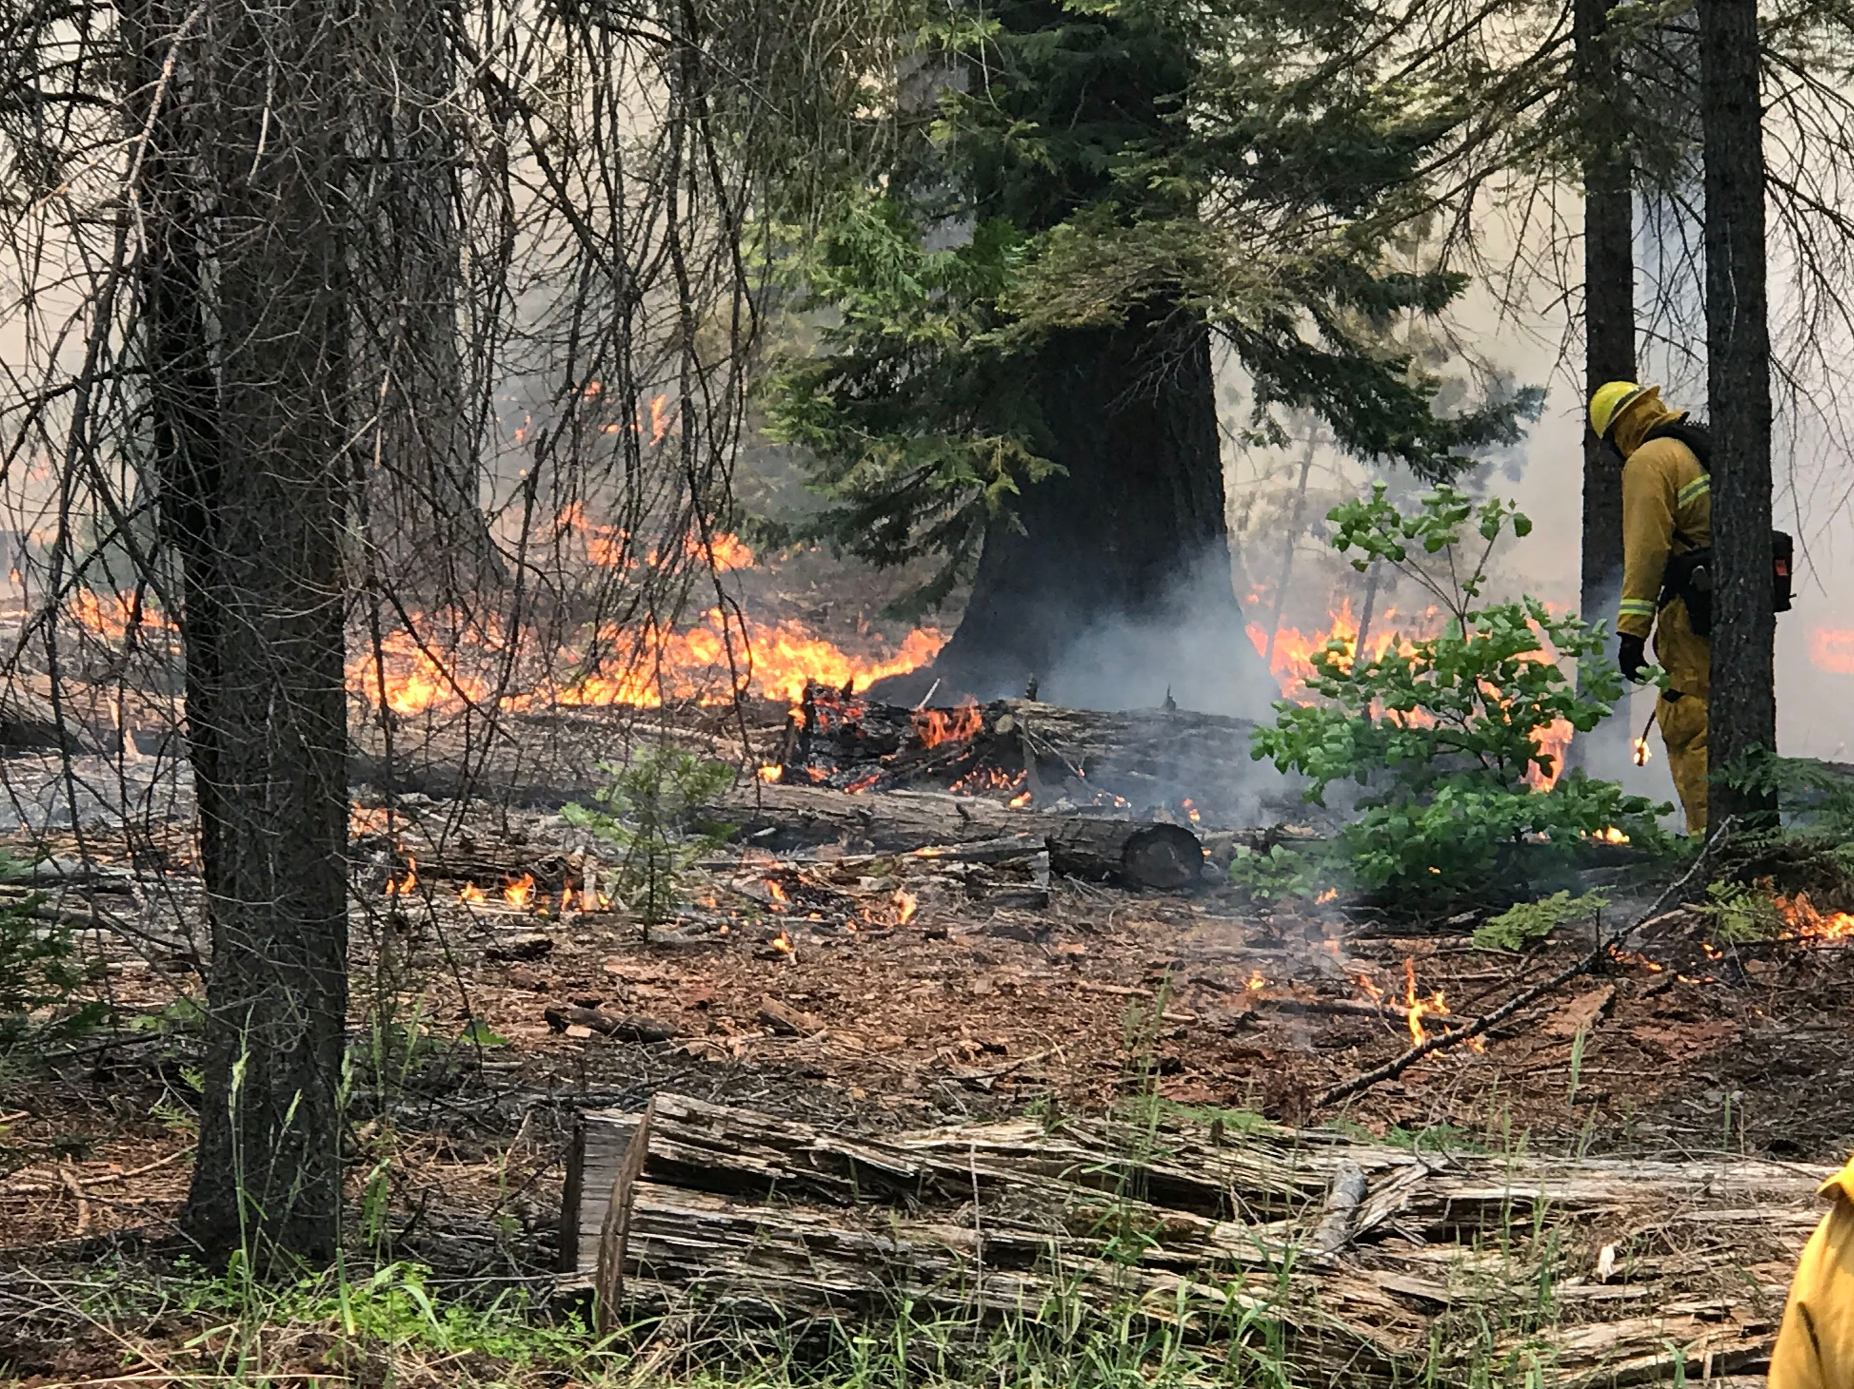
Fire Spread Model (WMFire)
Ecohydrologic Model
Fire Spread Model
Fire Effects Model
Matches language of RHESSys and has level of complexity commensurate with the data uncertainty of projections.

Slide 14
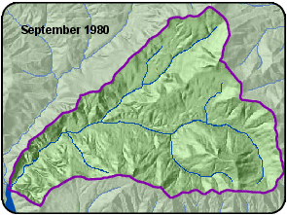
Fire Spread Model
Stochastic fire spread based on…
Fuel load
Moisture
Wind
Slope
Output
Map of fire spread
Measure of understory fire intensity.
Kennedy et al. (2017) IJWF

Slide 15
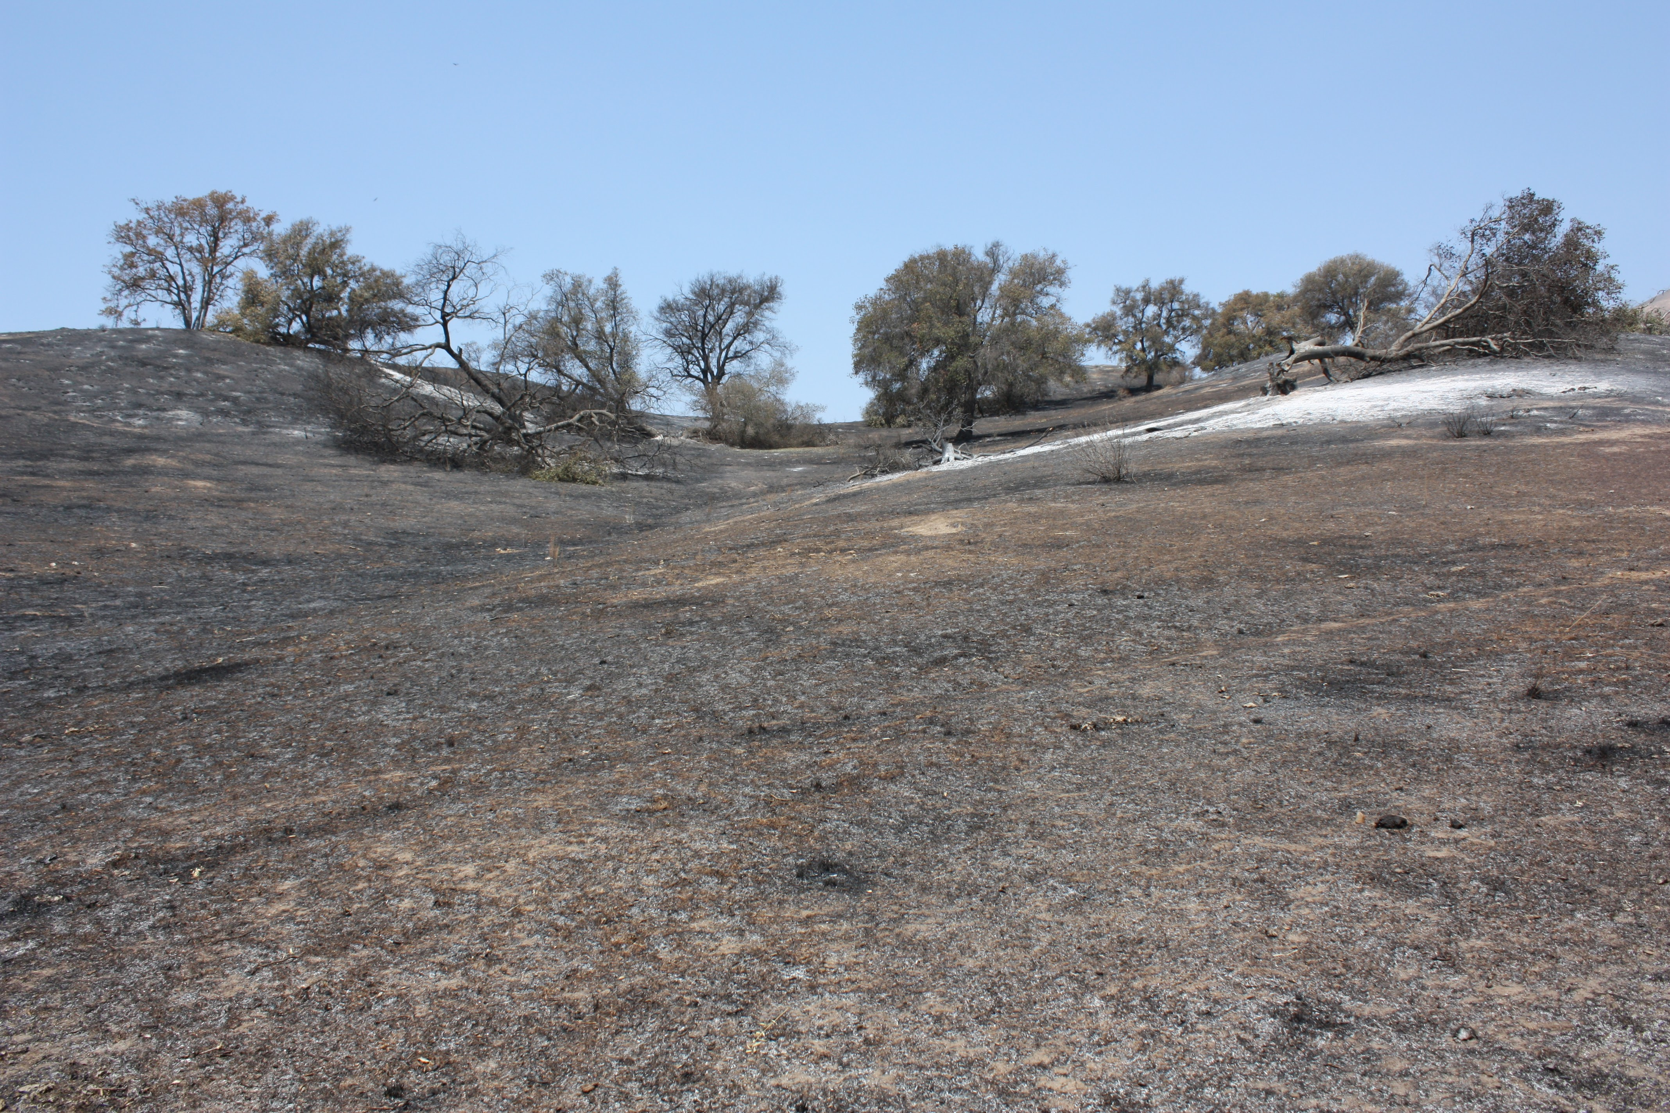
Fire Effects Model
Ecohydrologic Model
Fire Spread Model
Fire Effects Model
Feedbacks to ecohydrologic model based on fire intensity and vegetation structure (aka ladder fuels).

Slide 16
Fire Effects Model
Bart et al. (2020) Ecol. Modeling

Slide 17
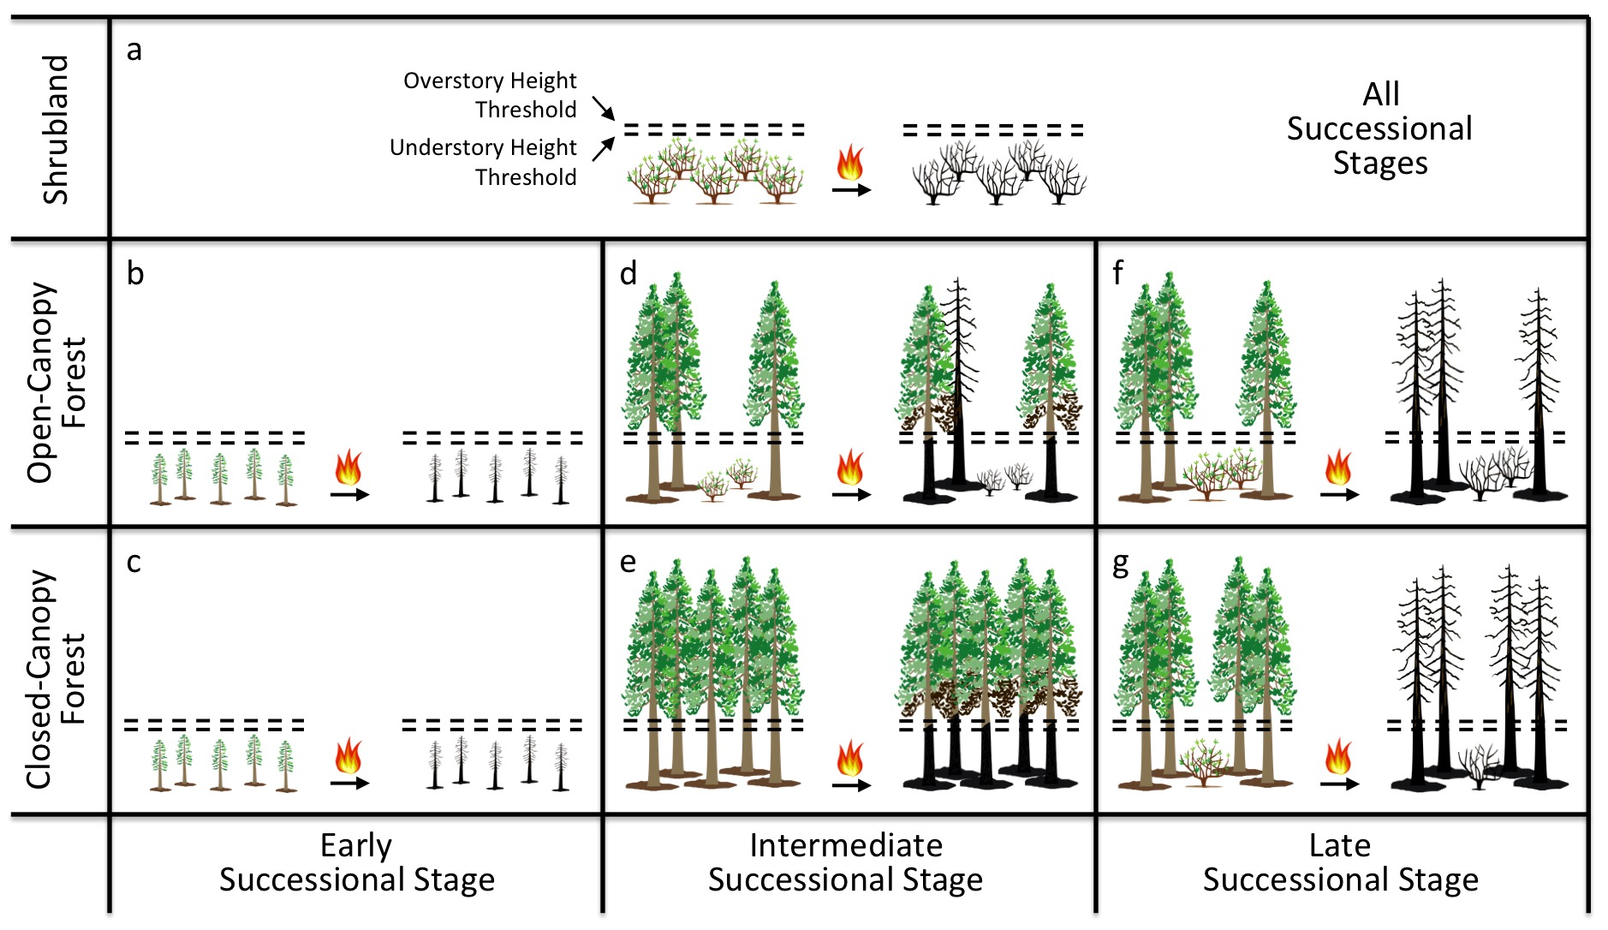
Fire Effects Model
Bart et al. (2020) Ecol. Modeling

Slide 18
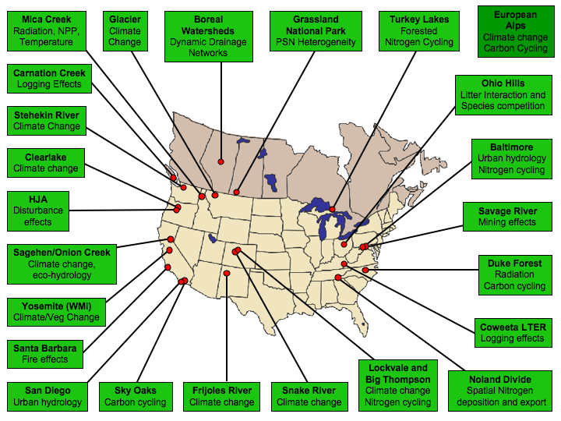

Slide 19
What really are process-based models and why do we use them?
Mechanistic representation of key interactions among climate, hydrology, plant C and N
Models are dependent largely on historic understanding of physiologic controls, but…
Key point is that they account for non-linear and spatially varying responses related to shifts in the dominant controls – temperature, light, water, nutrients
BALANCE: WATER, ENERGY, CARBON, NUTRIENTS

Slide 20
Downloading RHESSys
RHESSys is open source and the program (including all code) can be freely downloaded from Github.
https://github.com/RHESSys/RHESSys

Slide 21
RHESSys workflow
Gather
Data
DEM
Format
Data
Meteorology
Observed
(Streamflow,
ET, PSN,
Soil Moisture)
GIS
(Spatial)
Create
RHESSys
Files
Time
Series
Vegetation/Soil
Land use
Running
RHESSys
Worldfile
Flowtable
Spin Up
Analyze
Results
Tecfile
Calibration
Climate
Scenario
Simulations
Spatial
(R, Grass)
RHESSys
Library of
Soil and
Vegetation
Parameters
Definition
Files
Temporal
(R)

Slide 22
RHESSys Input files
Climate Files
Definition files
Worldfile
Flowtable
Tecfile

Slide 23
RHESSys Input files
RHESSys requires daily climate inputs for precipitation, minimum and maximum air temperature. Additional optional inputs can also be included.
Climate Files
Definition files
Worldfile
Flowtable
Tecfile

Slide 24
RHESSys Input files
Climate Files
Definition files
The definition files describe characteristics of the variables associated with each object (level) of the spatial hierarchy.
Worldfile
Flowtable
Tecfile

Slide 25
RHESSys Input files
Climate Files
Definition files
The worldfile defines the landscape representation within RHESSys. It is based on a hierarchical structure that describes each spatial level containing progressively finer units.
Worldfile
Flowtable
Tecfile

Slide 26
RHESSys Input files
Climate Files
Definition files
Worldfile
The flowtable describes connectivity between patches within a hillslope. The flowtable is necessary when explicit routing is going to be incorporated into the model.
Flowtable
Tecfile

Slide 27
RHESSys Input files
Climate Files
Definition files
Worldfile
Flowtable
RHESSys is structured as an event driven simulation, where most of the process modeling occurs between events. The TEC file, or Temporal Event Control file, tells RHESSys when certain events occur.
Tecfile

Slide 28
Climate Files
RHESSys requires daily climate inputs for precipitation, minimum and maximum air temperature (there are also a number of optional climate inputs. If optional climate sequences are not available/used, a process model within RHESSys will provide estimates of these variables).
Format: Station (basestation) or gridded data (e.g. netcdf)
These climate inputs are linked to zones in the landscape representation by a base station ID affiliated with that zone. A single base station will typically serve multiple (or all) zones within the landscape, however, many base stations can also be used.
Format:
separate file for each time series input – one daily value, starting date on first line
date formats for RHESSys files are Year, Month, Day, Hour
climate files associated with the same base station must all have the same prefix
a filename extension specifying the kind of climate variable (ie. precipitation, maximum or minimum temperature) contained in each file is attached to the end of the prefix.
prefix is then given in the base station description file, directing it to read in all climate files with that prefix.

Slide 29
Climate base station & daily inputs
101 base_station_id
100.0 x_coordinate
100.0 y_coordinate
485.0 z_coordinate
3.5 effective_lai
160.0 screen_height
hja_prime_annual annual_climate_prefix
0 number_non_critical_annual_sequences
hja_prime_monthly monthly_climate_prefix
0 number_non_critical_monthly_sequences
../clim/cs2met daily_climate_prefix
2 number_non_critical_daily_sequences
tavg
daytime_rain_duration
hja_prime_hourly hourly_climate_prefix
0 number_non_critical_hourly_sequences
cs2met.tmax
cs2met.tmin
cs2met.tavg
cs2met.rain
cs2met.daytime_rain_duration
1959 10 1 1
14.4
16.7
17.8
16.7
1959 10 1 1
2.8
3.9
5
6.1
1959 10 1 1
8.6
10.3
11.4
12.2
1959 10 1 1
0
0.0086
0.0356
0.0569
1959 10 1 1
0
11
24
24

Slide 30
Time Series Data
Zone level: Required
Minimum daily temperature
Maximum daily temperature
Precipitation
Zone level: Optional
Day length
Duration of rainfall
Incoming longwave radiation
Incoming direct shortwave radiation
Incoming diffuse shortwave radiation
Nitrogen deposition as N03
Nitrogen deposition as N0H4
Incoming direct PAR radiation
Incoming diffuse PAR radiation
Relative humidity
Mean daytime temperature
Average daytime temperature
Night time temperature at sundown
Soil temperature
Vapor pressure deficit
Wind speed
Carbon dioxide
Minimum temperature lapse rate
Maximum temperature lapse rate
Patch level: Optional
Irrigation
Fertilizer N03
Fertilizer NH4

Slide 31
Definition files
Definition files (default files) can be thought of as parameters describing typical soil, vegetation, and land use characteristics.
describe characteristics of the variables associated with each object (level) of the spatial hierarchy.
parameters are assigned values that stay constant through time
every model object from basins through strata in the worldfile has an associated definition file – related by the ID in the definition file
describe the performance of the parameters associated with an object.
For example:
patch object has associated definition files that describe the characteristics of the soil type identified in a patch, stratum level has definition files that describe vegetation characteristics/behaviour
library of commonly used parameter files assigned to specific soil, vegetation, and land use types have been developed, based on extensive literature research.

Slide 32
Definition file formats
The basin and hillslope definition file structures contain definition file identifiers. The definition identifier maintains consistency of every object from basin through strata that has that basin/hillslope definition identifier. Hillslope def files have optional parameters that can be included regarding groundwater and routing timestep.
hill.def
basin.def
1 hillslope_default_ID
1.0 sat_to_gw_coeff
1.0 gw_loss_coeff
24 n_routing_timesteps
1 basin_default_ID
zone.def
1 zone_default_ID
0.000029 atm_trans_lapse_rate
0.0015 dewpoint_lapse_rate
10.0 max_effective_lai
0.0064 lapse_rate
0.0254 pptmin
0.75 sea_level_clear_sky_trans
0.4 temcf
0.003 trans_coeff1
2.2 trans_coeff2
1.0 wind
0 max_snow_temp
-1 min_rain_temp
0.0016 n_deposition (kg/m2/yr)
The zone definition file contains atmospheric parameters associated with zone objects. The values provided in the standard zone definition file are likely to be reasonably invariant for many environments, therefore, is a good first source in the absence of atmospheric research specific to a study site.

Slide 33
soil_sandyloam.def
3 patch_default_ID
1 theta_psi_curve
3.000000 Ksat_0
0.120000 m
0.435000 porosity_0
4000.000 porosity_decay
0.000000 P3
0.204000 pore_size_index
0.218000 psi_air_entry
0.010000 psi_max
200.0000 soil_depth
0.400000 m_z
0.000000 detention_store_size
1.000000 deltaZ
10.00000 active_zone_z
-10.0000 maximum_snow_energy_deficit
0.000000 snow_water_capacity
10000.00 snow_light_ext_coef
0.050000 snow_melt_Tcoef
0.000000 max_heat_capacity
0.000000 min_heat_capacity
0.280000 albedo
1.000000 mobile_N_proportion
0.120000 N_decay
0.700000 sand
0.100000 clay
0.200000 silt
The soil and land use definition files associated with the patch object address the routing and input of water at the patch level. Soil definition files describe characteristics of particular soil types. Land use definition files account for additional nitrogen and water inputs from developed areas.
The land use def file accounts for additional nitrogen and water inputs from developed areas. There are currently four land use def files:
undeveloped, urban, agriculture and septic
lu_undev.def
1 landuse_default_ID
0.0 irrigation(m/m2/year)
0.0 fertilizer_NO3(kg/m2/year)
0.0 fertilizer_NH4(kg/m2/year)
0.0 septic_NO3_load(kg/m2/year)
0.0 septic_water_load (m/m2/year)
0.0 detention_store_size

Slide 34
veg_douglasfir.def
7 stratum_default_ID
TREE epc.veg.type
0.8 K_apsorbtance
0.1 K_reflectance
0.1 K_transmittance
1.0 PAR_absrptance
0.0 PAR_reflectance
0.0 PAR_transmittance
0.5 epc.ext_coef
0.00024 specific_rain_capacity
0.00024 specific_snow_capacity
0.002 wind_attenuation_coef
-999.9 ustar_overu
1.5 mrc.q10
0.21 mrc.per_N
0.2 epc.gr_perc
1.0 lai_stomatal_fraction
0.1 epc.flnr
0.03 epc.ppfd_coef
15.0 epc.topt
40.0 epc.tmax
0.20 epc.tcoef
-0.65 epc.psi_open
-2.5 epc.psi_close
0.0 epc.vpd_open
3500.0 epc.vpd_close
0.006 epc.gl_smax
The stratum definition files describe characteristics of different vegetation types and associated processes such as carbon allocation, radiation interception, respiration, stomatal physiology, phenology, etc...
Leaf on/off, leaf/root/wood turnover, can employ different allocation strategies.
Optional parameters available for vegetation, i.e. branch mortality.

Slide 35
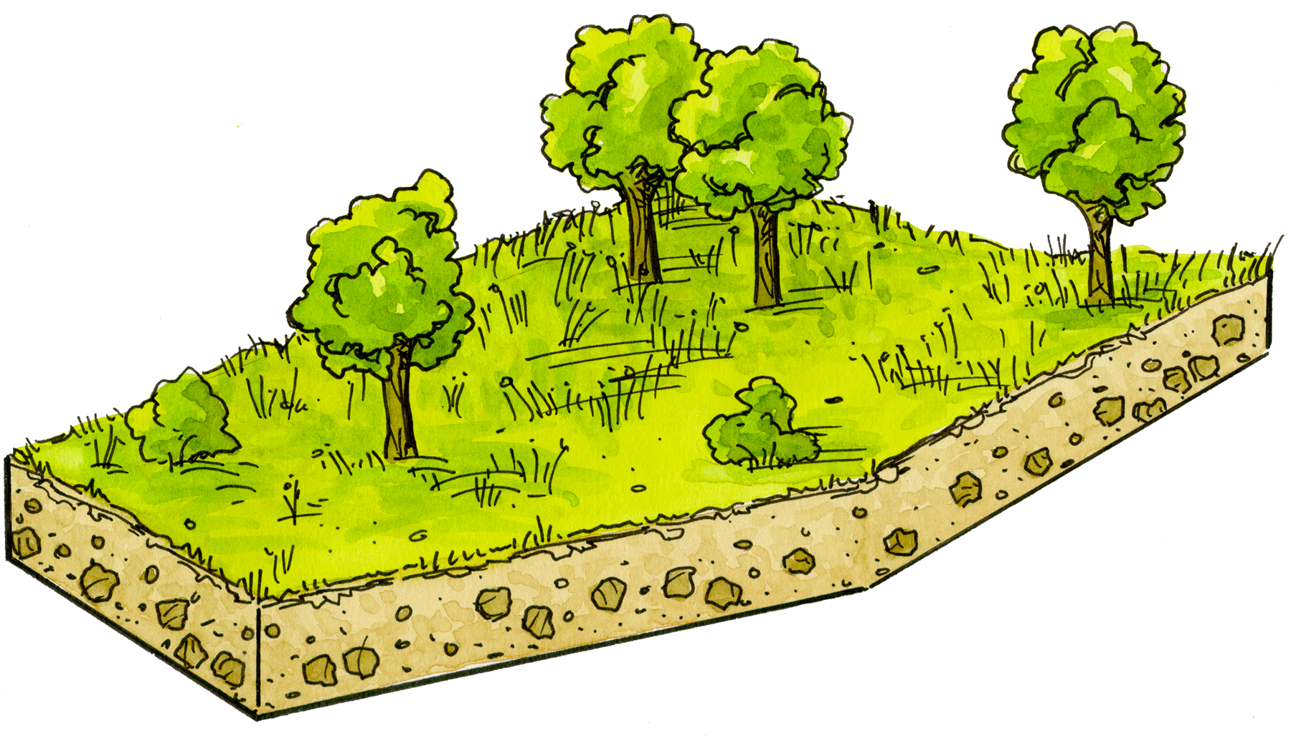
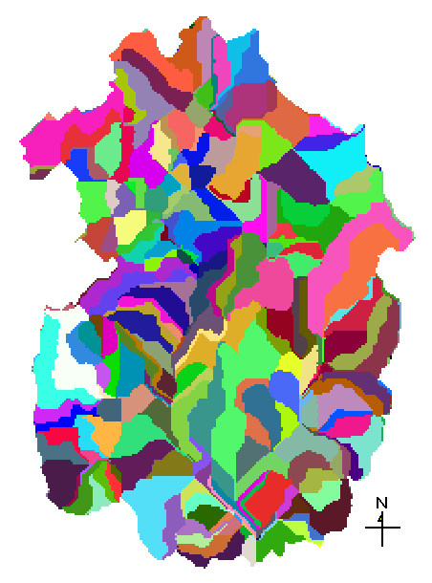
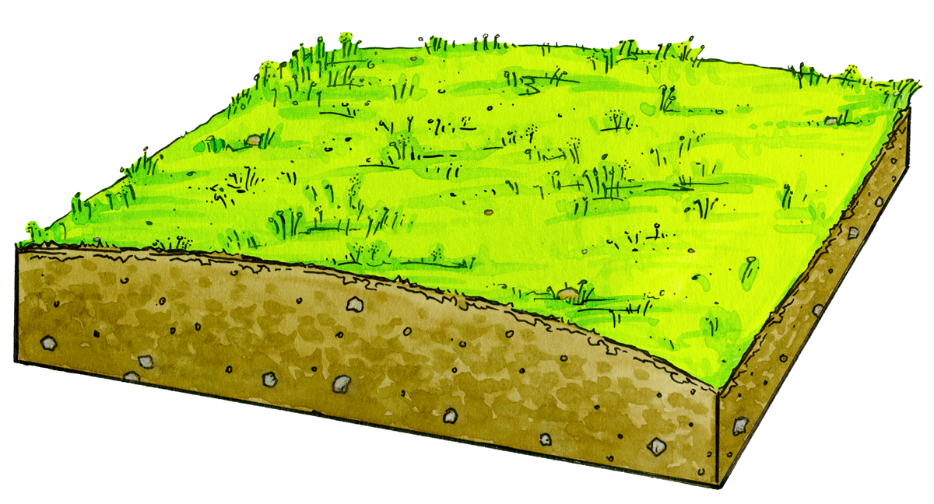
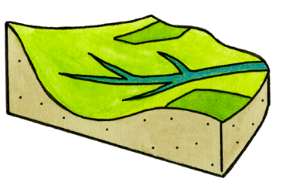

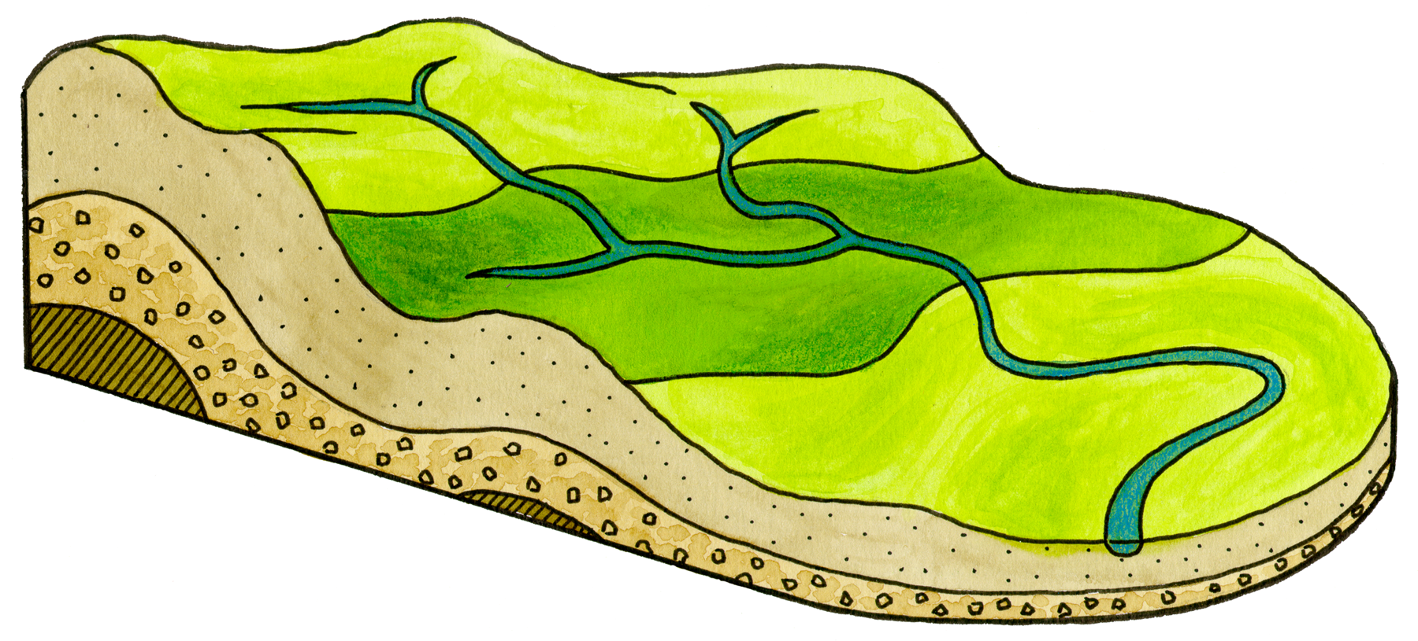
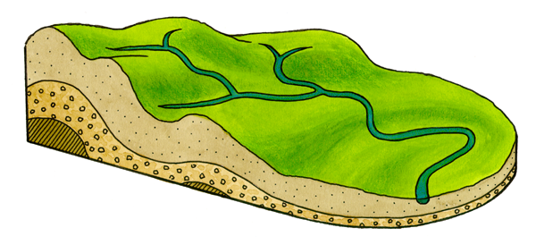
Worldfile: Spatial hierarchy
Hierarchical and Distributed Elements
Land Cover/Land Use
Patch Objects
Patch
Zone
The worldfile defines the landscape representation within RHESSys. It is based on a hierarchical structure describing each spatial level containing progressively finer units.
Hillslope
The RHESSys architecture models the spatial distribution and spatial-temporal interactions between the different processes at the watershed scale.
Each level is associated with a different process that has specific storage, flux and definition variables appropriate for that level.
Watershed

Slide 36
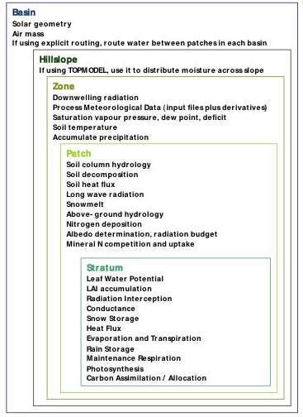
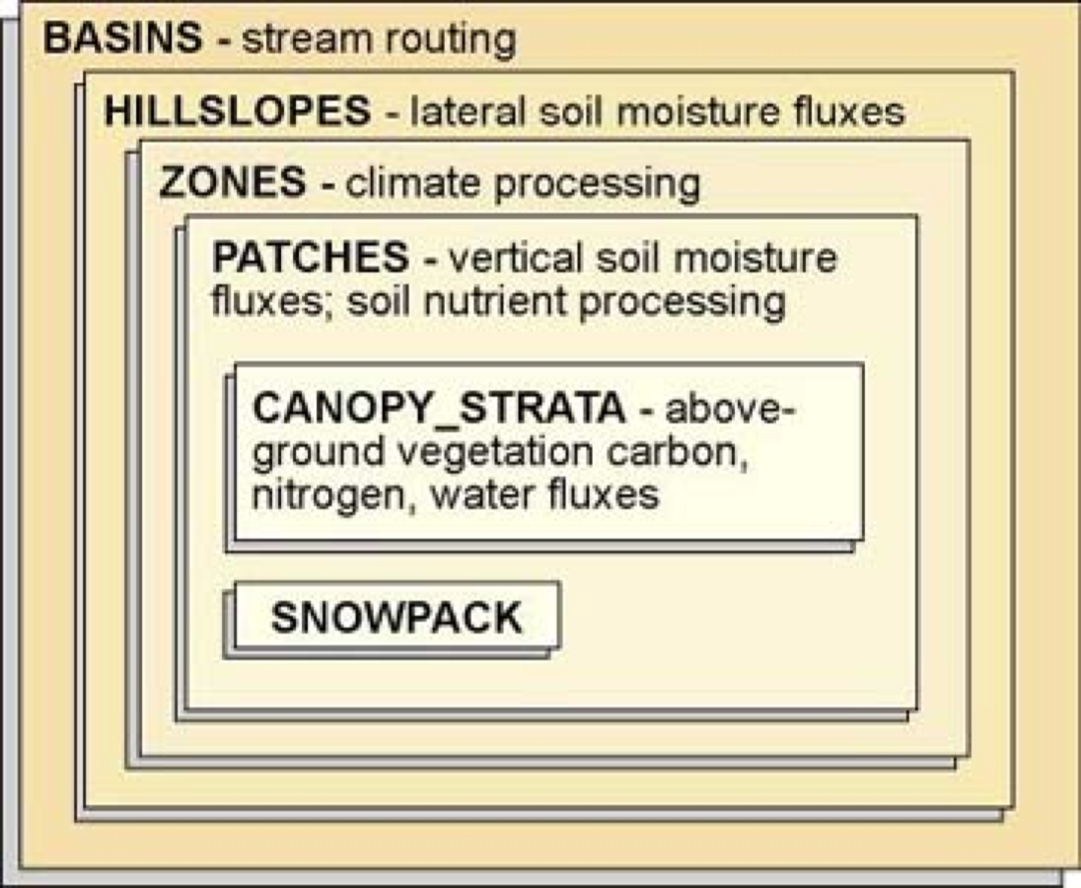
Defining the spatial hierarchy (GIS-based process)

Slide 37
Worldfile: RHESSysPreprocessing & Template
The worldfile is generated with a R program, RHESSysPreprocessing that references the input maps and a text document (template) that defines initial state variables (the starting point, or value, for each variable). Within the worldfile (and internally within the RHESSys simulation), each spatial level is associated with the following items:
Identifier: each instance within a level is assigned an ID based on the map used to partition that level.
State Variables: values for stores and fluxes organized at each spatial level are initialized at the start of the simulation, typically changing as the simulation runs (i.e.. saturation deficit within the patch level, LAI within the stratum level)
A link to definition file variables: values set for definition file variables remain constant throughout the simulation and are usually associated with a standard class for that level of the spatial hierarchy, i.e. patch defs are defined for different soil types, stratum defs are defined for different vegetation types.
A link to a climate station: supports multiple input climate stations (zone level). Allows input climate data to vary spatially.

Slide 38
There are 3 things that need to be initialized in the template:
1. Definition of the spatial layers
Spatial definition of the world objects (ie. basin, hillslope, zone, patch, and stratum) can be identified by looking at the lines beginning with an underscore (ie. _basin).
Each level in the spatial hierarchy is defined using a raster map, A specific format must be used to define the various partitions as follows:
spatial_level map_name extent
Spatial level indicates the level of the spatial heirarchy
map_name identifies the GRASS raster map which defines the spatial partition
Extent specifies the number of vertical layers defined at that particular level of the spatial hierarchy. The extent parameter allows for non-spatial partitioning at a given level in the spatial hierarchy. The current version of RHESSys only allows non-spatial partitioning to occur at the stratum level. Thus, for all levels other than canopy stratum, extent should be equal to 1.
Object type and associated processes:
_basin - defines the drainage basin, full extent of location being modeled.
_hillslope - defines areas which drain to a single point or stream reach.
_zone - denotes areas of similar climate.
_patch - soil moisture processes and carbon and nitrogen cycling.
_stratum - vertical layers within a patch (ie. vegetation)

Slide 39
2. Initialization of state variables - Generally, there are two ways to initialize state variables:
The format for variables in the template is as follows:
Variable_name Function Constant_Value/Map
assign a constant value - homogenous coverage
A. Assign a constant value
Example: soil_default_ID value 3.0
(variable_name) (function) (constant_value)
Assigning a constant value of 3 (the default ID for sandyloam) to the variable soil_default_id within the _patch level would indicate a constant soil type (sandyloam) across the landscape.
use a map to assign values- varies throughout the landscape
requires a reference map containing multiple ID's. The default ID's used to identify soil and vegetation types in a map correspond to the ID's in the default filles
B. Use a map to assign values
Example: soil_default_ID mode variable_soils
(variable_name) (function) (map)
The map variable_soils is a map of soils that vary across the landscape. The function mode
takes the modal values from the map used. There are different ways to use maps (mode,
averages, with an equation – see website for more information). Note that for map ID's with variables that should not be averaged, mode must be used.

Slide 40
3. Assigning default ID's and base-stations
The beginning (header) of the template file is the header
lists the default and climate station files that will be used to describe the parameters associated with the world objects.
Each level of the spatial hierarchy (basin, hillslope, zone, patch, and stratum) has default files associated with it for soil, vegetation, landuse, climate.
The template format lists the number of default
files that correspond to a given variable
(i.e. number of soil or vegetation types), as well as
the number of climate base stations, followed by
the location (path) and name of the default file or
base station file.
1
../defs/basin.def
1
../defs/hill.def
1
../defs/zone.def
2
../defs/soil_sandyloam.def
../defs/soil_gravellyloam.def
1
../defs/lu_undev.def
3
../defs/veg_douglasfir.def
../defs/veg_westhemlock.def
../defs/veg_silverfir.def
2
../clim/cs2met_base
../clim/vanmet_base

Slide 41
Flowtable
Defines linkages between spatial units
Denotes upslope and downslope neighbors for each patch
Supports multiple flowpath routing
Includes partitioning of flow to downslope neighbors
Differentiates between patches which contain streams and upslope patches
Defines flow network topology
Created from R program: RHESSysPreprocessing

Slide 42
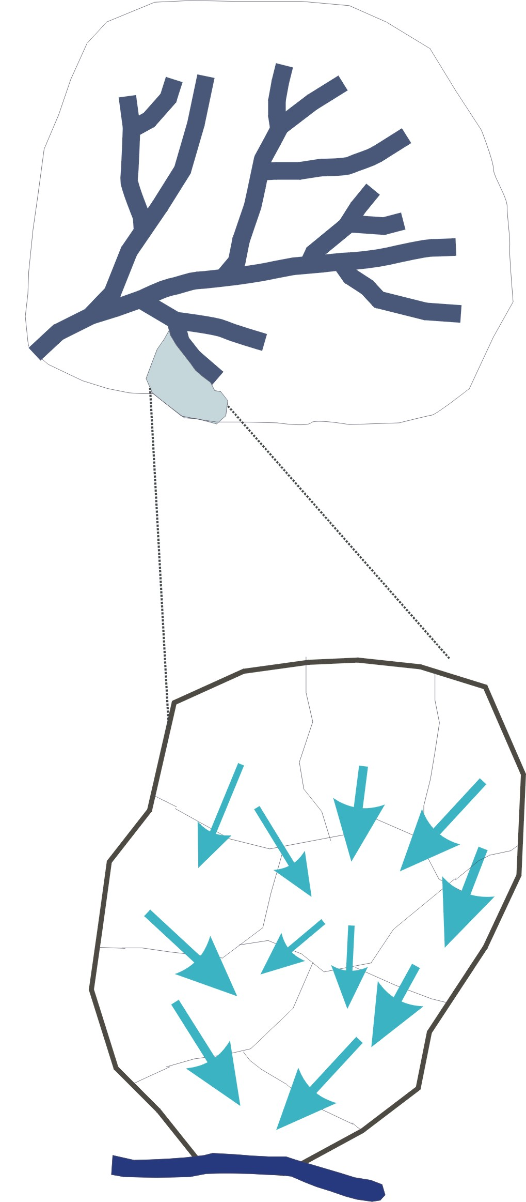
RHESSys Routing
Basin
Stream Flow Routing
Hillslope
Patch Routing
(within hillslope routing of overland and saturated subsurface throughflow)

Slide 43
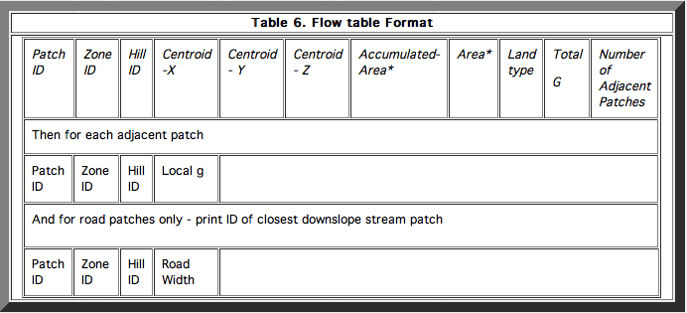
Flow table format
5789
8845 8845 89 255.0 368.0 1615.0 1.000000 1 0 217.198914 4
8703 8703 85 0.33458975
8705 8705 89 0.19382583
8844 8844 100 0.27912131
8846 8846 89 0.19246311

Slide 44
TEC file (temporal event control file)
Temporal Events (occur dynamically while simulation is running)
Printing output
Redefinition of the worldfile - dynamics disturbances - changing state variables (e.g. reduction of carbon stores to simulate fire/logging/development) at a specific point in the simulations
Output current state (used to spin model up for use in subsequent simulations)
Redefine of the flowtable - changing drainage topology - use to simulate road, sewer network construction

Slide 45
Tecfile formatting:
1. The TEC file is created in a text editor (such as VI)
2. Events must be listed in order of execution
3. Only one event per line is allowed, no blank lines are allowed
4. The format for events in the TEC file is as follows:
Year Month Day Hour Printing_event
When executing several printing events that start on the same
day, the events must be sequential. Two events cannot be
scheduled to happen at the same time. Therefore, if you have
two printing events scheduled on the same day, make the first
printing event start on hour 1, the second on hour 2, etc...
1987 10 1 1 print_daily_on
1987 10 1 2 print_daily_growth_on
2006 9 30 1 output_current_state

Slide 46
Output and Run-time Options
TEC file – determines the timing of output
RHESSys command line options – determine the spatial scale of output
-b = basin output
-g = growth output
-h = hillslope output
-z = zone output
-p = patch output
-c = stratum output
Note – you should always end the simulation one day later than the last day for which you want some event to occur. As most processes in RHESSys update on a daily basis, they require processing until the last minute of that day. Therefore, ending the simulation at the beginning of the following day effectively ends it immediately after processing from the previous day has just ended.
For hillslope, zone, patch and stratum, every spatial unit across the can be output, or just one chosen unit can be output by giving it’s “address”, i.e., to output results for just one particular stratum, give that stratums basin, hillslope, zone, patch, and stratum ID:
-c 1 24 584 584 584

Slide 47
RHESSys outputs
Daily
Daily
Growth
Monthly
Yearly
Streamflow
Saturation Deficit
Evap/Trans LAI
Snowpack
GPSN
Plant/Soil Respiration
Plant/Litter/Soil C&N
Nitrification/Denitrif
Streamflow
DOC/DON
LAI PSN ET
Vegetation N uptake
GPSN
Plant Respiration
New Carbon
Denitrification
Basin
Saturation Deficit
Total Stream Outflow
LAI PSN Evap/Trans
Groundwater
Maintenance Resp
Plant/Litter/Soil C&N
Mineralized N
Organic C&N Loss
Streamflow
DOC/DON
LAI PSN ET
Vegetation N uptake
Nitrate to Stream
Organic C&N loss
ET NPSN
Mineralized N
Hillslope
Rainfall/Snowfall
Temperature
VPD
Radiation
Precipitation
Direct Radiation
Diffuse Radiation
Avg. Min/Max Temp
Zone
N/A
N/A
Soil Moisture
Evap/Trans
PSN
Subsurface flow
LAI PSN
Plant/Soil Respiration
Litter/Soil Carbon
Soil/Surface Nitrate
Soil Moisture
Net Nitrate Flux
ET LAI NPSN
Vegetation N Uptake
# Day below Sat thresh
Net Nitrate Flux
ET NPSN MaxLAI
Organic C&N loss
Patch
Stratum
LAI NPSN
Radiation
Rain/Snow Interception
Conductance
Leaf/Root/Stem C
Maint/Growth Resp
LAI PSN
Coarse Woody Debris C
LAI
NPSN
Leaf Water Potential
NPSN
Leaf Water Potential
Notes:
Add output figure - Change figure to the time/level new figure
USER Practice: Run a script to generate basin output; look at basin output in R (look at several variables),
use that to choose two time periods to output spatial; save this R image for future use
Edit the tec files to have output for thw two select time periods
Edit the script to correspond
Run
Read in to GRASS
Look at in GRASS
Maybe do a subtraction in R. mapcalc to show differences between two time periods
Repeat Reading in for a different variable

Slide 48
Output files for each of the four temporal levels will always be built and written to the output directory.
Hourly
Daily
Monthly
Yearly
However, if a command was not included in the tec file for a spatial level, no output will be printed to that output file.
Maintenance is suggested on a regular basis to eliminate empty files (the output directory can get very crowded!)
Be careful when choosing finer scale level output – the time period of printing may result in very large output files.

Slide 49
Output and Run-time Options (new method!!!)
Output filters

Slide 50
Multiscale Routing

